Slide 1


Bank Management System
Page-1

Slide 2

Software
Developers
Nabanita Sarkar (Emp ID-815944)
Ayan Mondal (Emp ID-815954)
Page -2

Slide 3
Table of Contents:
Page-4 Abstract
Page-5 Aim of the project
Page-6 Problem Description
Page-7 User Features
Page-8 Software Requirements
Page-9 ER Diagram
Page-10 Use Case Diagram
Page-11 Level-0 DFD
Page-12 Level-1 DFD
Page-13 Structure of Project
Page-14-25 Snapshots/Outputs
Page-26 Conclusion
Page-3

Slide 4



The Bank Account Management System is an application for maintaining a person's account in a bank. In this project I tried to show the working of a banking account system and cover the basic functionality of a Bank Account Management System. To develop a project for solving financial applications of a customer in banking environment in order to nurture the needs of an end banking user by providing various ways to perform banking tasks. Also to enable the user’s work space to have additional functionalities which are not provided under a conventional banking project. The Bank Account Management System undertaken as a project is based on relevant technologies. The main aim of this project is to develop software for Bank Account Management System. This project has been developed to carry out the processes easily and quickly, which is not possible with the manuals systems, which are overcome by this software. This project is developed using Spring MVC,JSP and MYSQL use for database connection.
Abstract
Page-4

Slide 5

The main objective is to create a web-based only system. which will help to maintain the bank account records, Maintain the transaction records of the customers. Easy to track all the banking activity a centralized system to maintain all the bank activity.
AIM
Page-5

Slide 6

The bank management system is an application for maintaining a person’s account in a bank. The system provides the access to the customer to create an account, deposit/withdraw the cash from his account, also to view reports of all accounts present. The following presentation provides the specifications for the system.
Problem Description
Page-6

Slide 7



Create Account – The user needs to create new account first to get a unique account number to login.
Login – After creating an account, The user need to login first to enable to access the system.
Manage Account – The user can view his/her account status such account number, current balance in your account, and the account type.
Money Transfer – The user can transfer money from one bank account to another bank account.
Loan application – The user can request a loan to the bank.
Manage Profile – The user can edit details information and can change password.
User Features of the Project
Page-7

Slide 8
Software Requirements:
Front-End : Jsp, Html, CSS, JS.
Server-side: Servlet.
Back-end: MYSQL.
Server: Tomcat 8.5.
TecM Advantage
Page-8

Slide 9
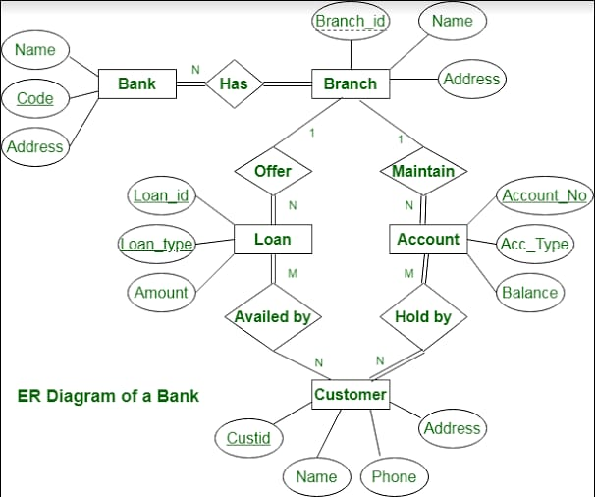
ER Diagram
Page-9

Slide 10
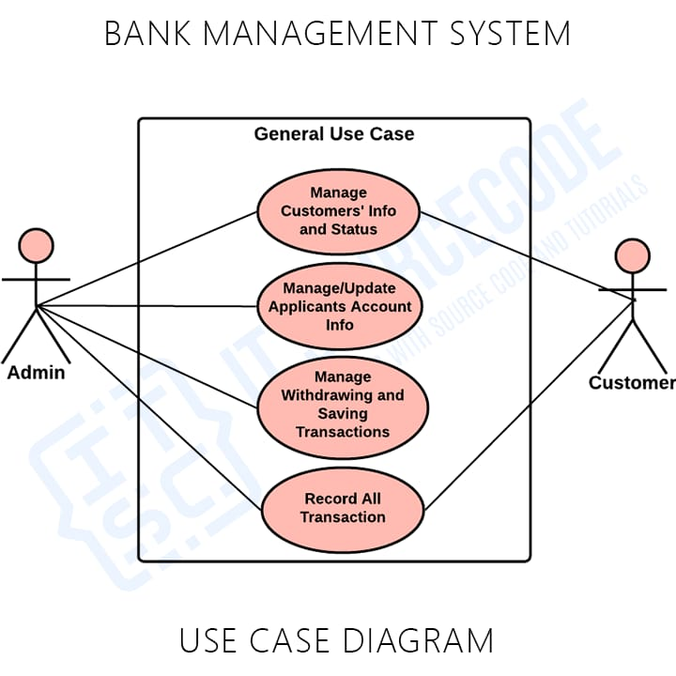
Use Case Diagram
Page-10

Slide 11
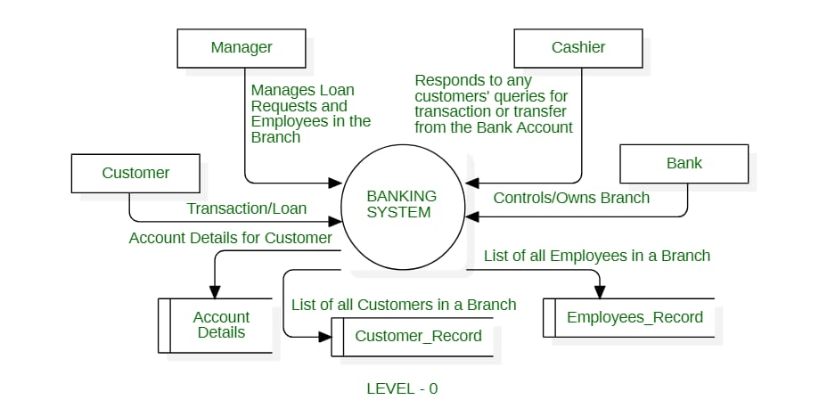
DFD-Level 0
Page-11

Slide 12
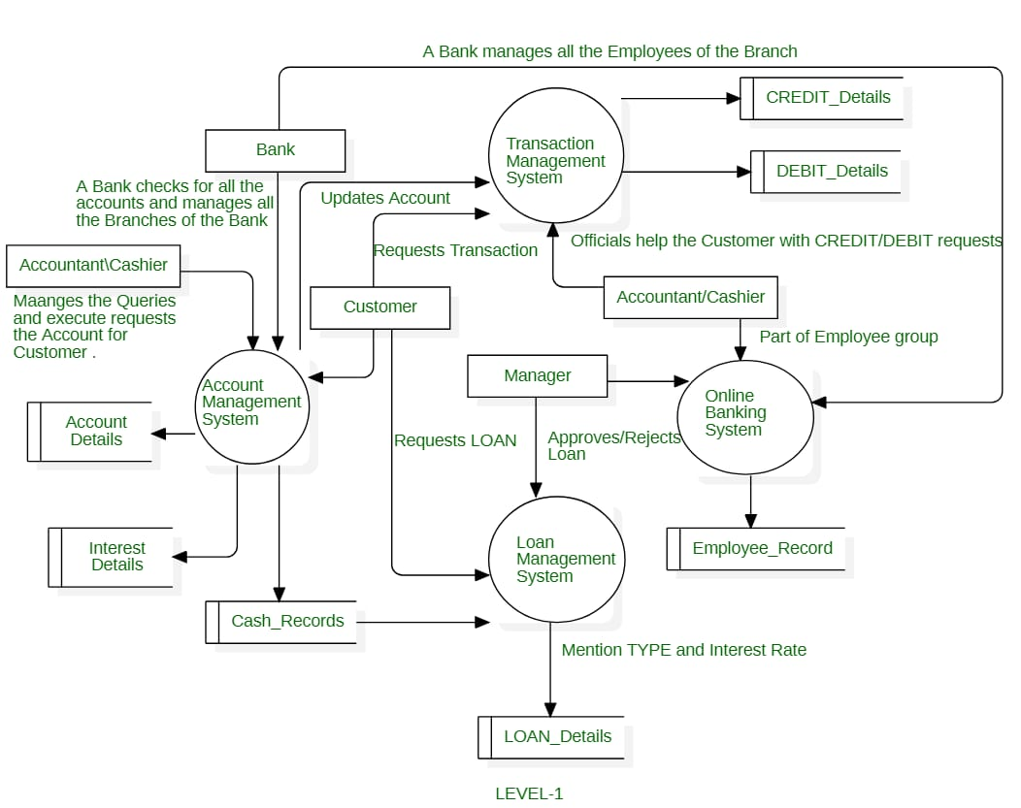
DFD-Level 1
Page-12

Slide 13
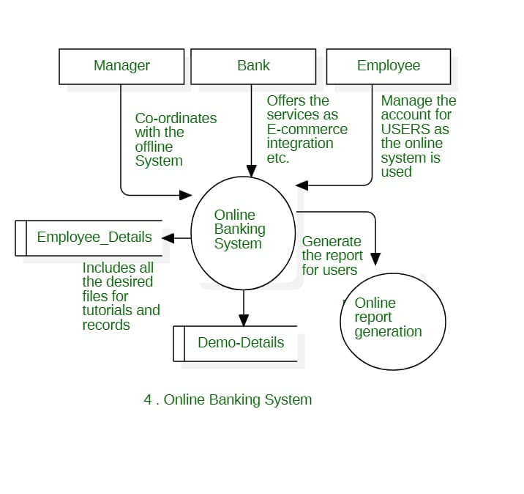
Structure of Bank Management System
Page-13

Slide 14
SNAPSHOTS
Page-14

Slide 15
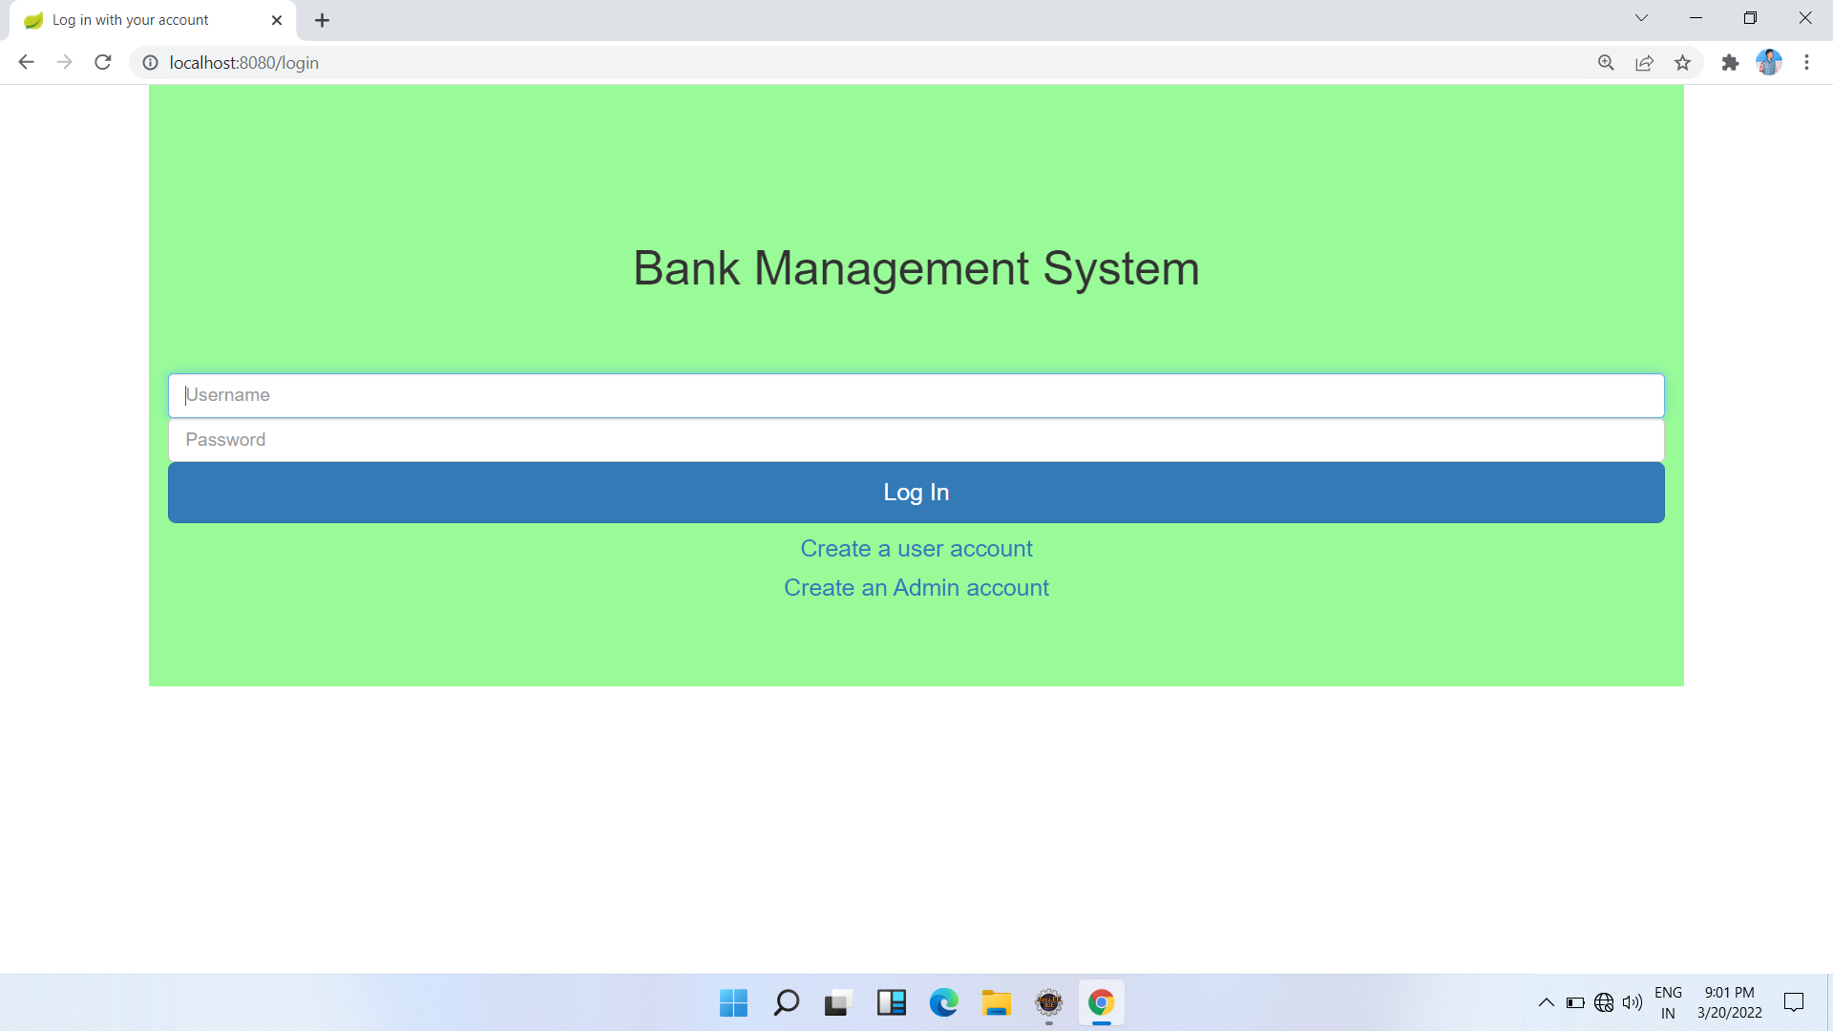
Homepage
Page-15

Slide 16
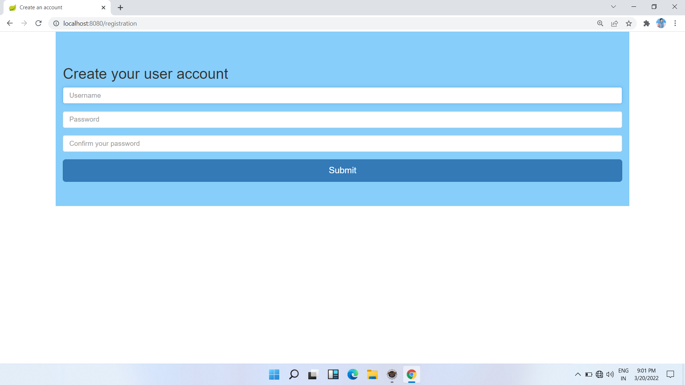
User Account
Page-16

Slide 17
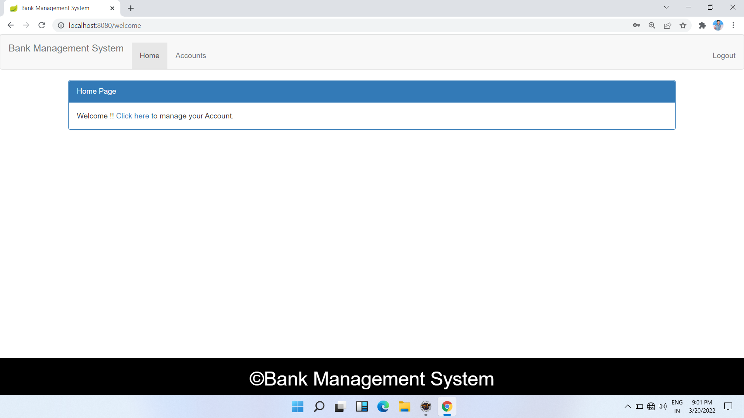
User Homepage
Page-17

Slide 18
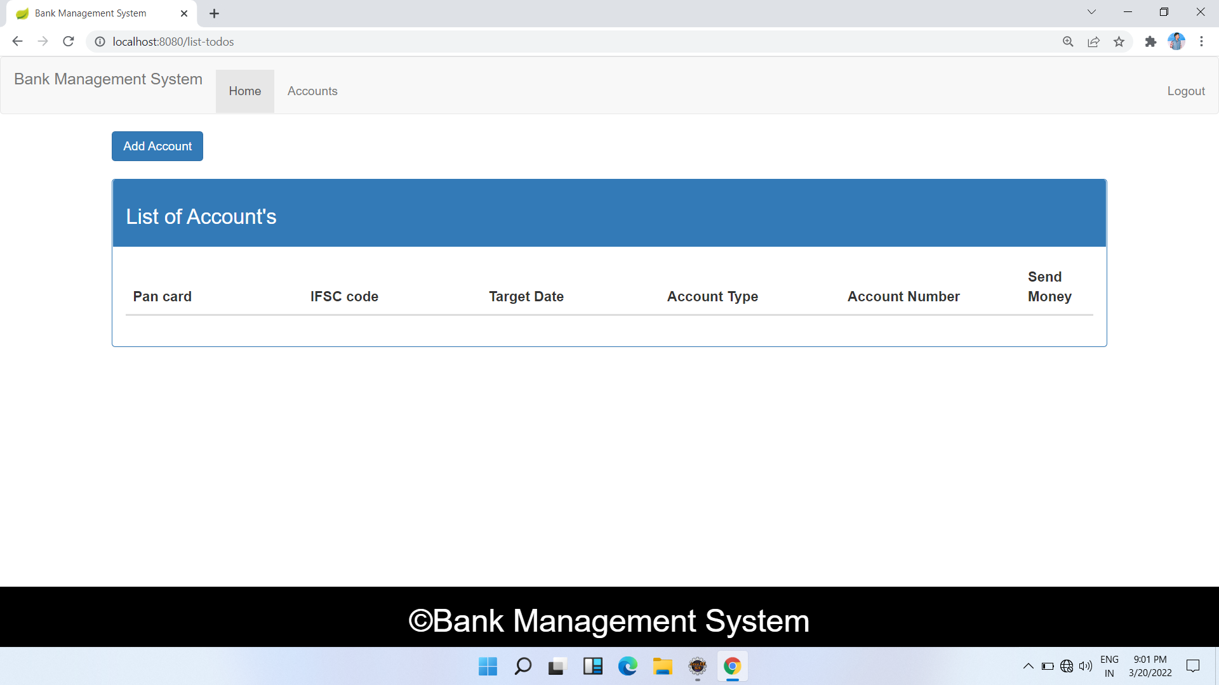
Page-18

Slide 19
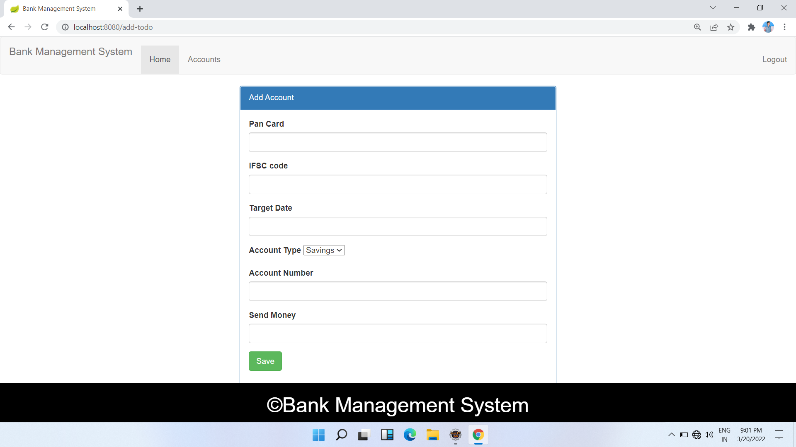
Page-19

Slide 20
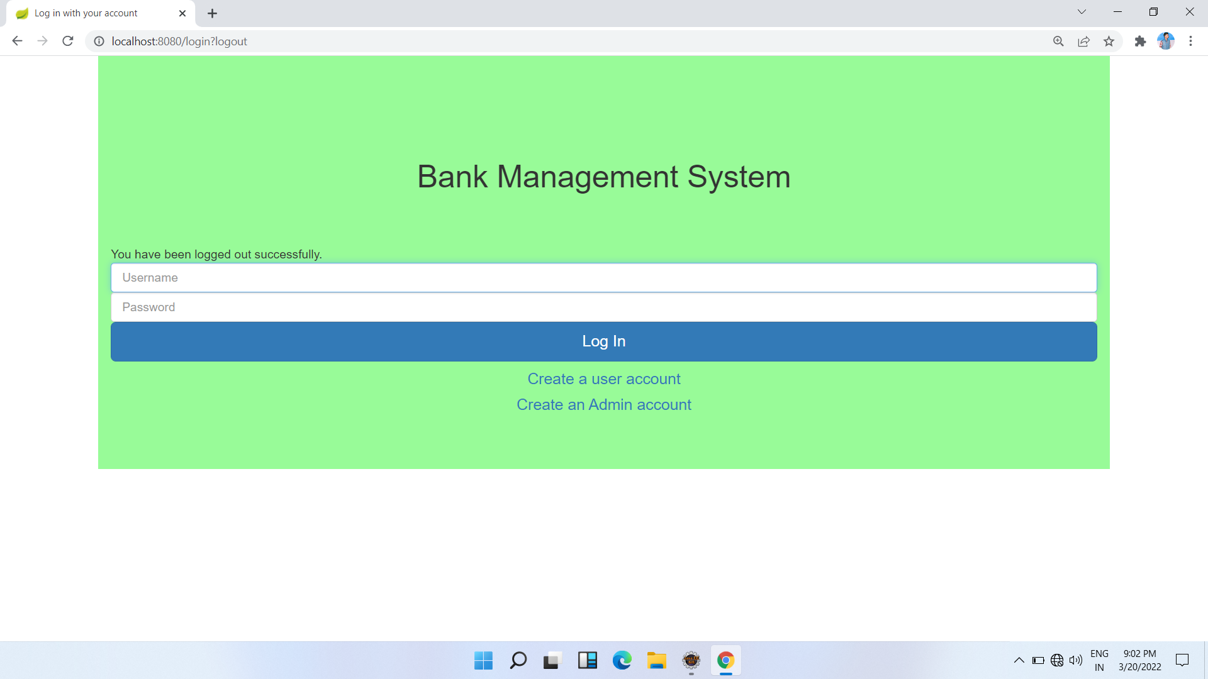
Page-20

Slide 21
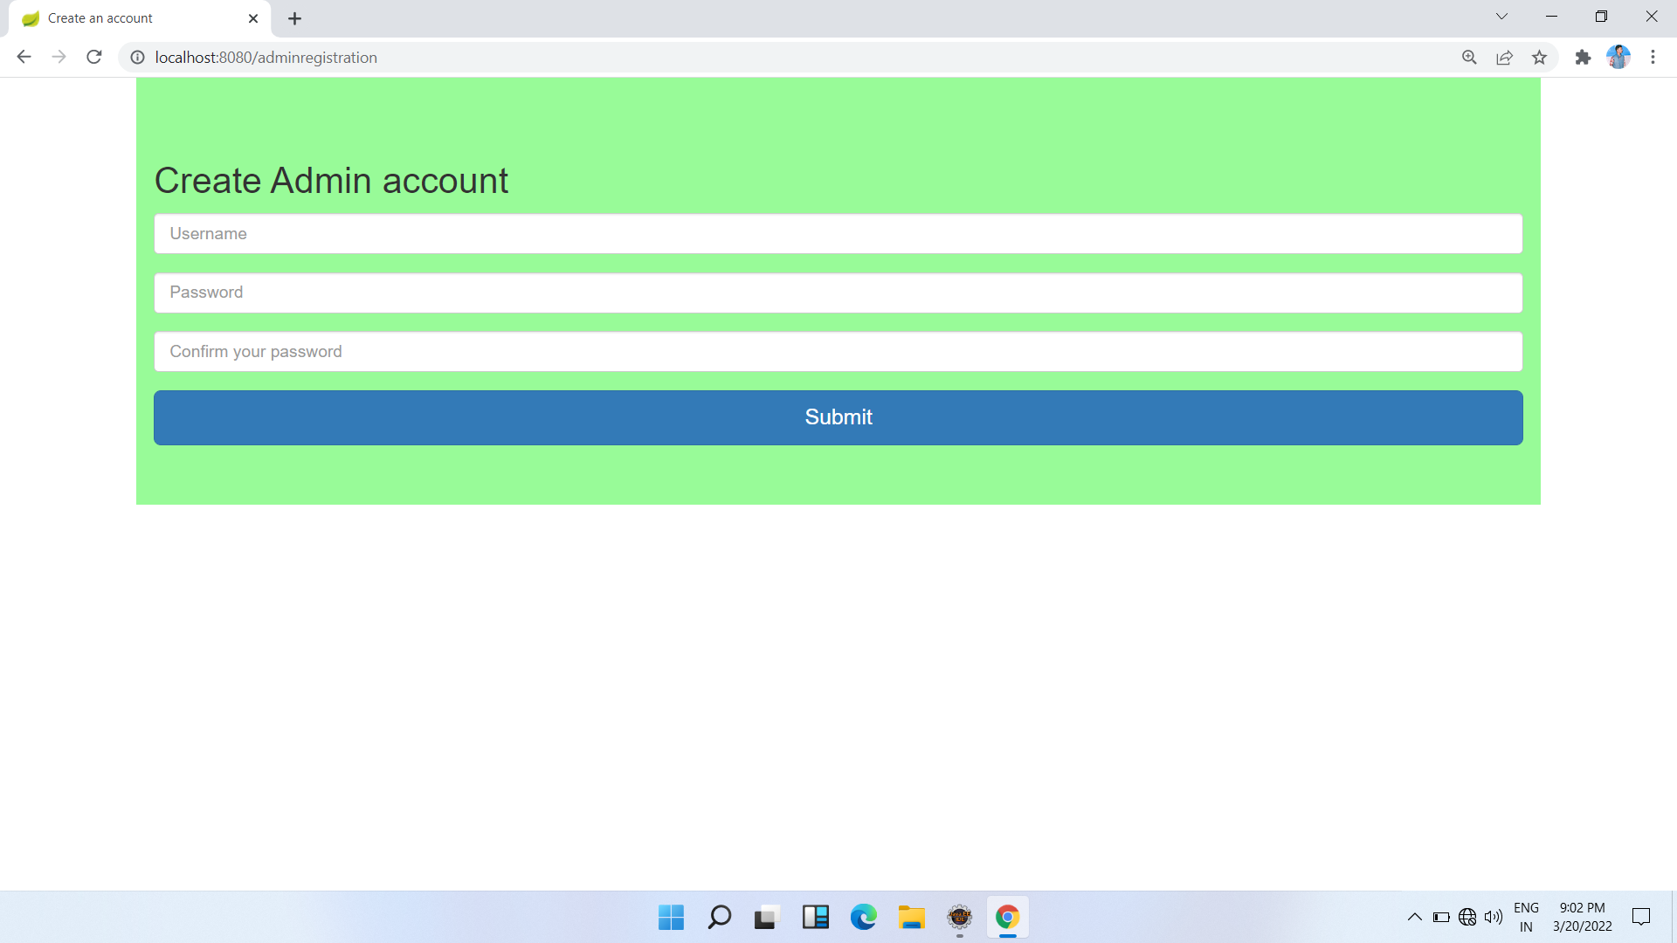
Admin Account
Page-21

Slide 22
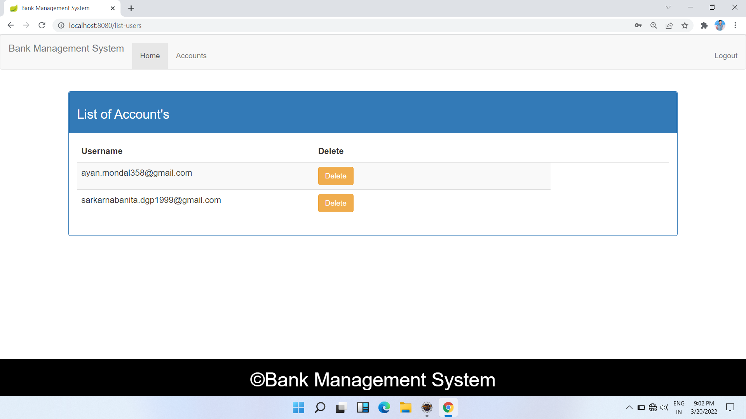
List of Account
Page-22

Slide 23
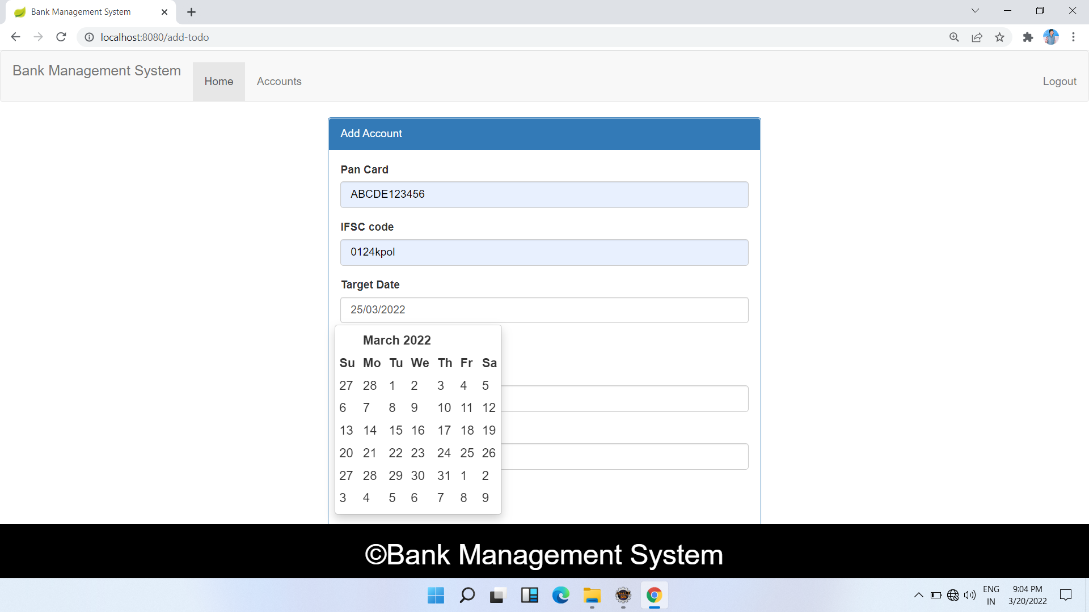
Page-23

Slide 24
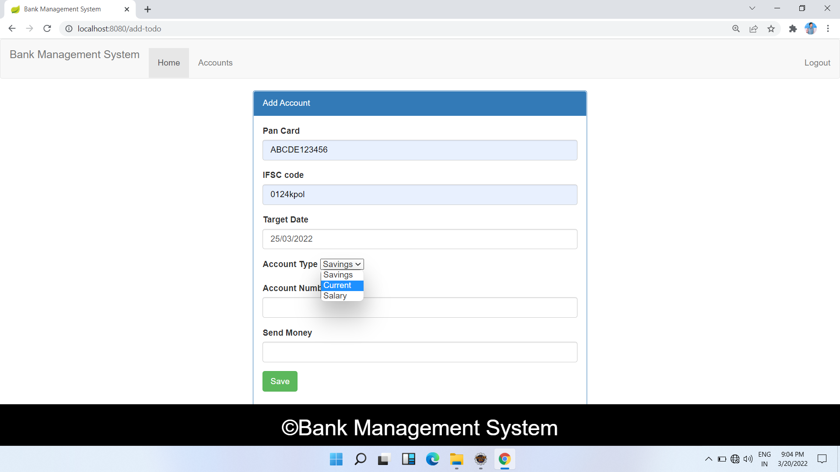
Page-24

Slide 25
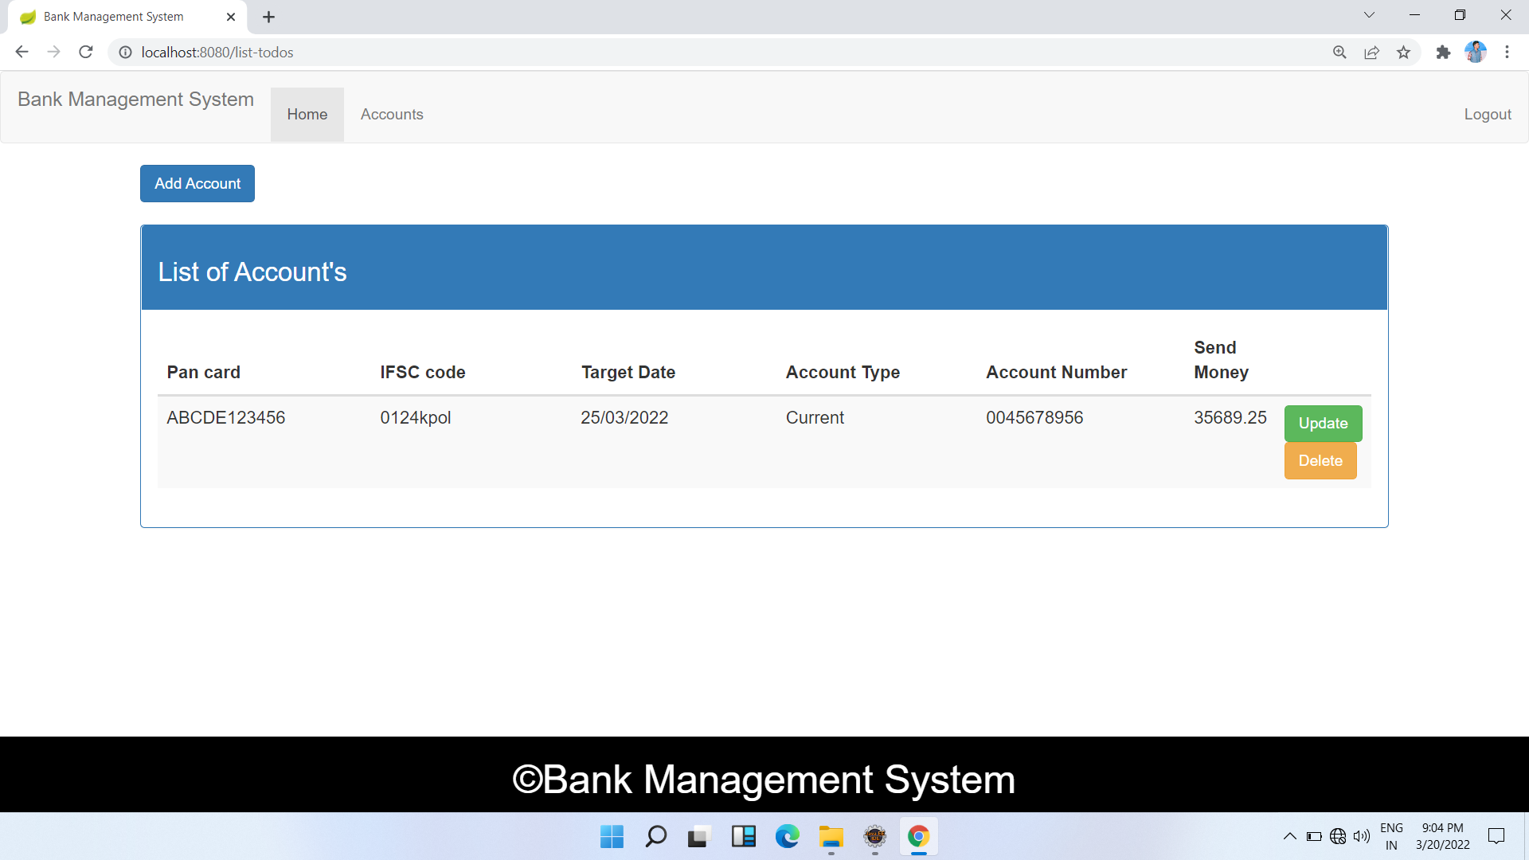
Page-25

Slide 26
Conclusion:
This project is developed to nurture the needs of a user in a banking sector by embedding all the tasks of transactions taking place in a bank.
Thus the Bank Management System it is developed and executed successfully.
Page-26

Slide 27
Thank You
Page-27

